Slide 1
Biogeochemistry I
Introduction to Isotopes
Prosper Zigah
Woods Hole Oceanographic Institution
pzigah@whoi.edu

Slide 2
Biogeochemistry I: Isotope biogeochemistry
What are Isotopes
Why care about stable isotopes?
Expressing Isotopic abundances
Isotope effects
Isotopic-mass balance calculations (two-component and multiple-component mixing models)
Applications to geochemical studies of the ocean and a lacustrine system
Presentation on

Slide 3
What are Isotopes:
Isotopes are atoms with the same number of protons but different number of neutrons
E.g. Isotopes of carbon: ¹²C (6 protons and 6 neutrons)
¹³C (6 protons and 7 neutrons)
¹⁴C (6 protons and 8 neutrons)

Slide 4
Types of Isotopes:
Stable isotopes: Do not decay radioactively
¹²C , ¹³C
¹H, ²H
Radio-isotopes : Unstable and decay radioactively
¹⁴C
³H

Slide 5
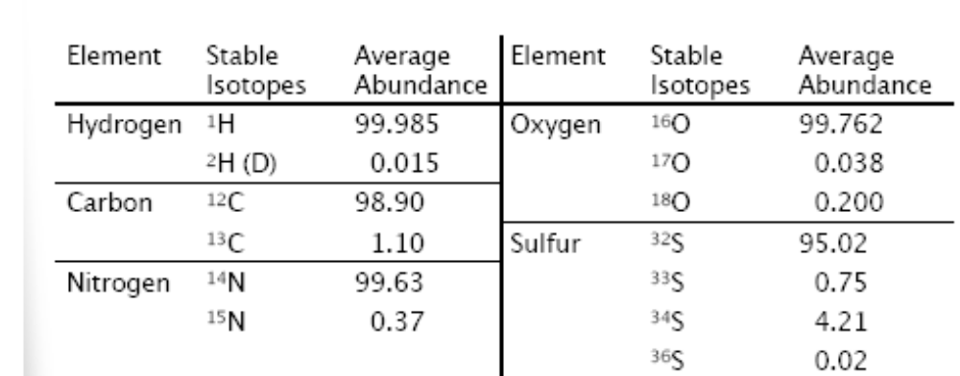
Common Light Element Stable Isotopes

Slide 6
Expressing Isotopic compositions
Absolute abundances
Atom percent: For eg. Atom percent ¹³C = [¹³C/¹³C+¹²C]* 100
Fractional abundance: fractional abundance of ¹³C ≡ ¹³F = [¹³C/¹³C+¹²C]
Isotope ratios
Generally reported as the ratio of a rare isotope to a more abundant isotope.
E.g. carbon isotope ratio = ¹³R = ¹³C/¹²C
For dual isotopic elements (with only 2 stable nuclides, e.g. C, H and N), there is a pretty straightforward relationship between F and R
¹³R = ¹³F / (1 – ¹³F)
¹³F = ¹³R / (1 + ¹³R)
For multi-isotopic elements eg. oxygen
¹⁸R = ¹⁸F / (1 – ¹⁷F - ¹⁸F)
¹⁸F = ¹⁸R / (1 + ¹⁷R + ¹⁸R)

Slide 7
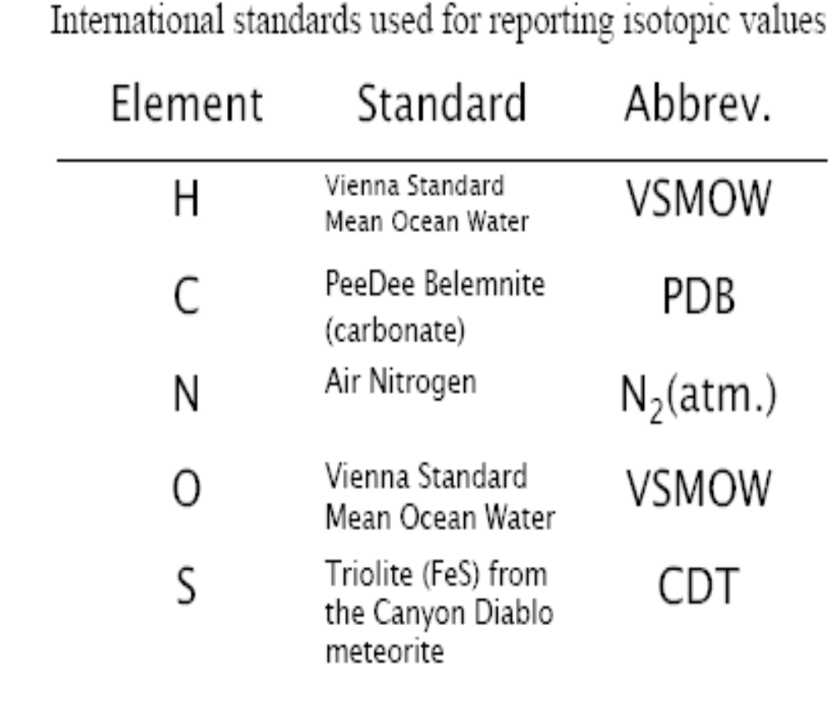
Delta notation
Urey 1948 and McKinney et al. 1950
δ expresses the isotope ratio relative to a standard
δ = [R_{sample}/R_{standard} – 1]*1000
R_{sample} is the isotope ratio of the sample
R_{standard} is the isotope ratio of a standard or reference material
‰ (permil or per mille)
Isotope ratio standards

Slide 8
Isotopic-mass balance calculations
Isotopic composition of pooled samples
Ʃδ *Ʃm = m₁*δ₁ + m₂*δ₂ + m₂*δ₂ +……
where
m is the molar concentrations of the element of interest
δ is the isotopic ratios
Example 1. A closed-system Lake Brian with dissolved inorganic carbon concentration [DIC] of 800 µmol C/L is fed by Lester, Ontonagon, and Brule rivers with DIC- δ¹³C of 0.6‰,1.8‰ and -0.5‰, respectively. What is the δ¹³C of the Lake DIC if the proportional contributions of Lester, Ontonagon, and Brule rivers to the lake DIC are 20%, 35% and 45%.
Example 2. The particulate organic matter (POM) in the coastal waters off Tema harbor has δ¹³C of -25‰, and derives primarily from terrigenous organic carbon with δ¹³C of -28‰ and in situ algae with δ¹³C of -21‰. Using two-component mixing model and accounting for isotopic mass balance and conservation of mass, calculate the proportion of terrigenous and algal carbon in the POM.

Slide 9
Isotopic-mass balance calculations
2. Isotope dilution analyses
Ʃδ *Ʃm = m_{sample}*δ_{sample} + m_{spike}*δ_{spike}
_{where}
Ʃδ = measured isotopic value of sample plus spike
Ʃm = Combined mass of sample and spike
m_{sample ,} m_{spike =} mass of sample and spike, respectively
δ_{sample ,} δ_{spike =} Isotopic value of sample and spike, respectively
3. Blank corrections
Ʃδ *Ʃm = m_{s}*δ_{s} + m_{b}*δ_{b}
_{Substituting} m_{s} = Ʃm – m_{b}, and rearranging gives
Ʃδ = δ_{s} – m_{b} (δ_{s} - δ_{b}) / Ʃm yielding an equation of the form y = a + bx
Plotting Ʃδ vs. 1/ Ʃm will give the blank-corrected accurate δ_{s} value as the y intercept.

Slide 10
Stable Isotope mixing models
IsoSource Model
IsoSource calculates ranges of source proportional contributions to a mixture based on stable isotope analyses when the number of sources is too large to permit a unique solution (> number of isotope systems + 1). The user supplies the isotopic signatures for the mixture and each of the sources.
2. MixSIR Model
MixSIR is a Bayesian isotopic modeling tool for partitioning the proportional contributions of potential sources to the bulk POC based on their δ¹³C and δ¹⁵N signatures. The MixSIR model works by determining probability distributions of sources contributing to the observed mixed signal while accounting explicitly for the uncertainty in the isotopic signatures of the sources and fractionation.

Slide 11
Measuring Isotopic Ratios
Convert the element into a stable gas
Clean/purify the gas from contaminants (online or offline)
Measure the isotopic ratios using Isotope ratio mass spectrometer (IRMS)

Slide 12
Measuring Isotopic Ratios
Carbon isotope ratio of dissolved organic carbon (DOC)
- Acidify to pH 2 and spurge to remove inorganic
carbon/carbonate
UV-Oxidize the organic carbon in the water to CO₂
Trap and purify the CO₂ on a vacuum line (trap the CO₂ with liquid N2 and flush out the incondensables)
CO₂ into IRMS and measure m/z
44 (¹²C-¹⁶O-¹⁶O)
45 (¹²C-¹⁶O-¹⁶O; ¹²C-¹⁷O-¹⁶O ; ¹²C-¹⁶O-¹⁷O)
46 (¹²C-¹⁸O-¹⁶O; ¹²C-¹⁶O-¹⁸O)
Carbon isotope ratio of carbonate
CaCO3 + acid = CO₂
CO₂ into IRMS and measure m/z
44 (¹²C-¹⁶O-¹⁶O)
45 (¹²C-¹⁶O-¹⁶O; ¹²C-¹⁷O-¹⁶O ; ¹²C-¹⁶O-¹⁷O)
46 (¹²C-¹⁸O-¹⁶O; ¹²C-¹⁶O-¹⁸O)
Simultaneous measurement of carbon and nitrogen Isotopic ratio of particulate organic matter (POM)/zooplankton/fish muscle
Flash combust material at 1200 ºC to CO₂ and NO₂.
Split the gas stream
One stream into a packed oxidation column to ensure complete oxidation to CO₂ and into IRMS
44 (¹²C-¹⁶O-¹⁶O)
45 (¹²C-¹⁶O-¹⁶O; ¹²C-¹⁷O-¹⁶O ; ¹²C-¹⁶O-¹⁷O)
Other split into a reduction column to reduce the NO₂ to N₂ and into the IRMS
28 (¹⁴N-¹⁴N)
29 (¹⁵N-¹⁴N)

Slide 13
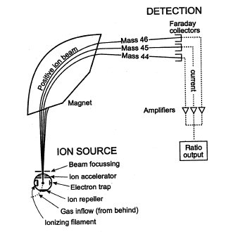
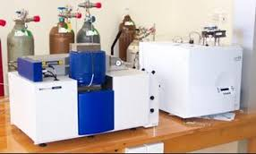
Isotope ratio mass spectrometer (IRMS)
Source: www.boundless.com

Slide 14
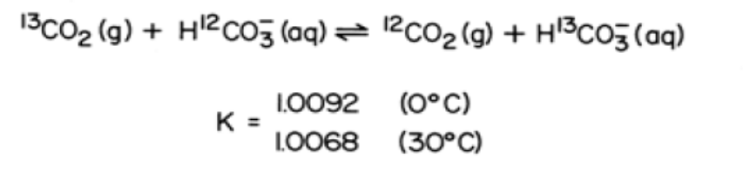
Isotopic fractionation
Kinetic isotope fractionation
The reaction and transport rates of one isotope is faster than the other
Could be caused by chemical, biological or physical processes
Eg. 1 Photosynthesis
CO₂ (δ¹³C = -8‰) to organic carbon (δ¹³C = -28‰)
2. Equilibrium isotope fractionation
Reaction in which a single atom is exchanged between two species
Distribution is determined by thermodynamics rather than kinetics
Eg. 1

