Slide 1
Biogeochemistry II
Introduction to biomarkers
Prosper Zigah
Woods Hole Oceanographic Institution
pzigah@whoi.edu

Slide 2
Analytical techniques I: Isolation and separation of Organic Matter
Organic matter
Bulk DOM
(0.7 µm GF/F Filtrate)
POM
Init DOM
(0.2 µm Gravity filtered)
Sinking POM
(sediment trap)
Suspended POM
(0.7 µm GF/F )
C18
SPE extraction
XAD
resins
Ultrafiltration
HMW DOM
(>1k Da)
LMW DOM
(<1k Da)

Slide 3
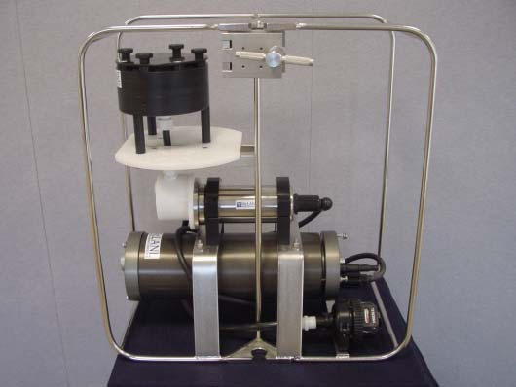
McLane WTS LV

Slide 4
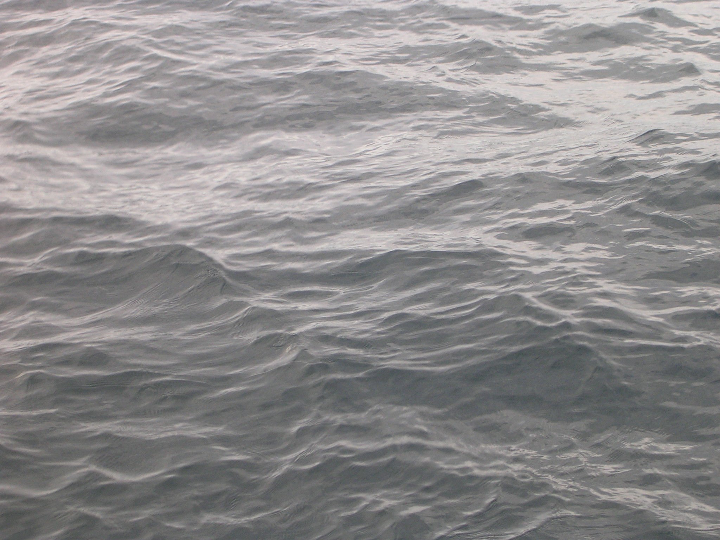
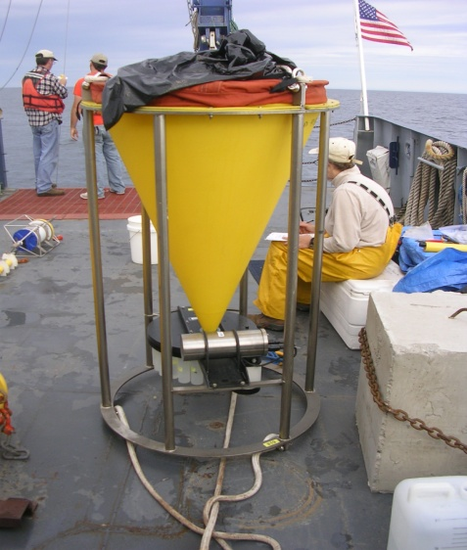
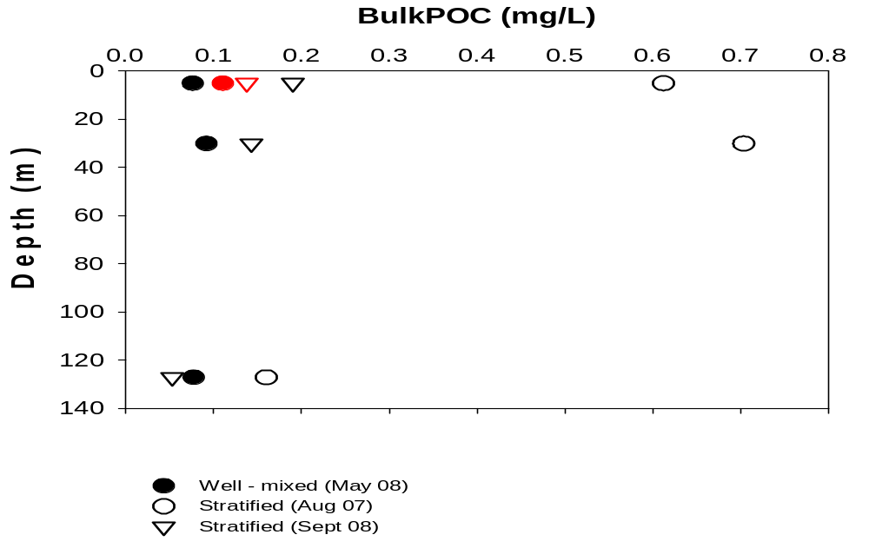
Biomarker analyses
Concentrations of major carbon pools in Lake Superior
POM (susp & sink)
[DIC] > [DOC] > [POC]
by an order of magnitude
Accelerated-solvent extracted (ASE)
Total lipid extract (TLE)
Bond elute column chromatography
Neutrals
Fatty acids
Bound phospholipids
Alumina column chromatography
Apolar
Polar
Rest
FAMES (via methylation)
GC
GC
Alkanes
TMS (via sylation with BSTFA)
GC Alcohols
Stratified [POC] is higher than isothermal [POC]

Slide 5
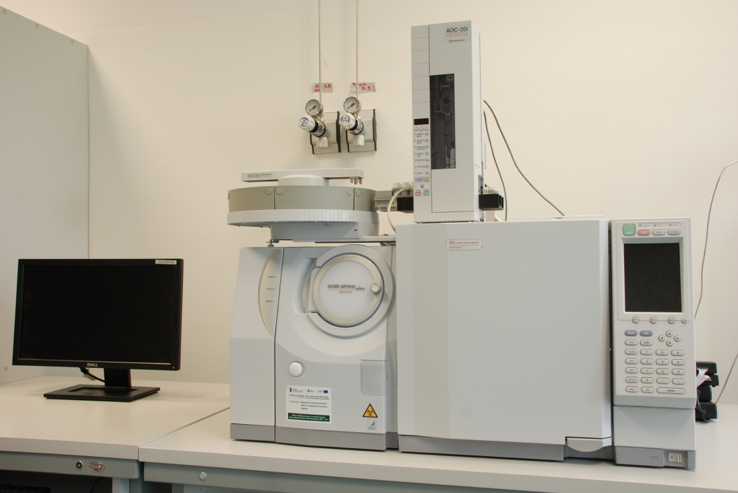
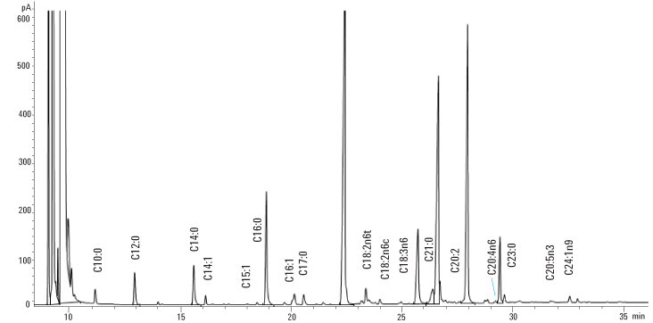
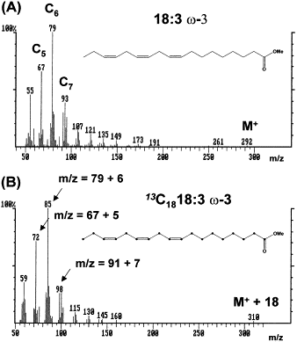

Slide 6
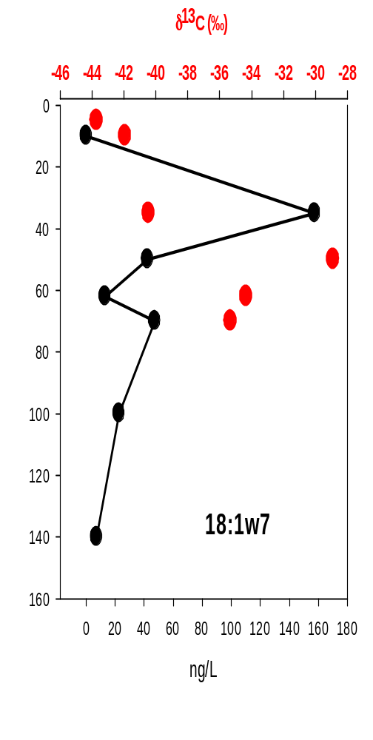
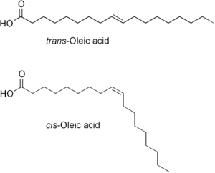
Biomarker for aerobic methanotroph
C18:1w7 Fatty acid
(Oleic acid)

Slide 7
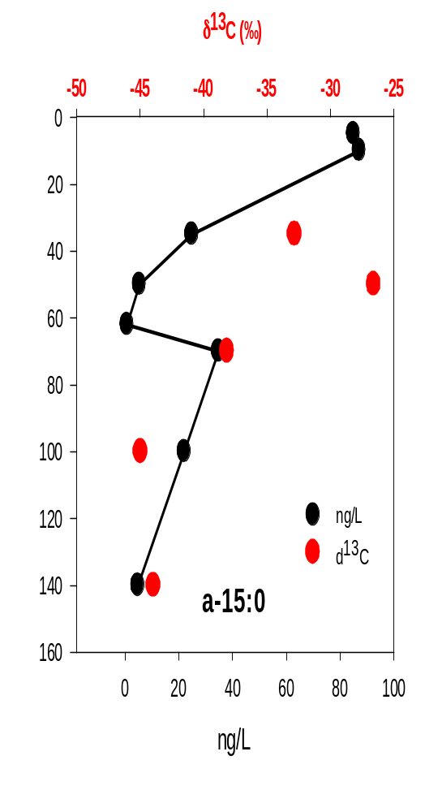

Biomarker for sulfate reducing bacteria
anteiso C15 Fatty acid
(anteiso-Pentadecanoic acid)

Slide 8
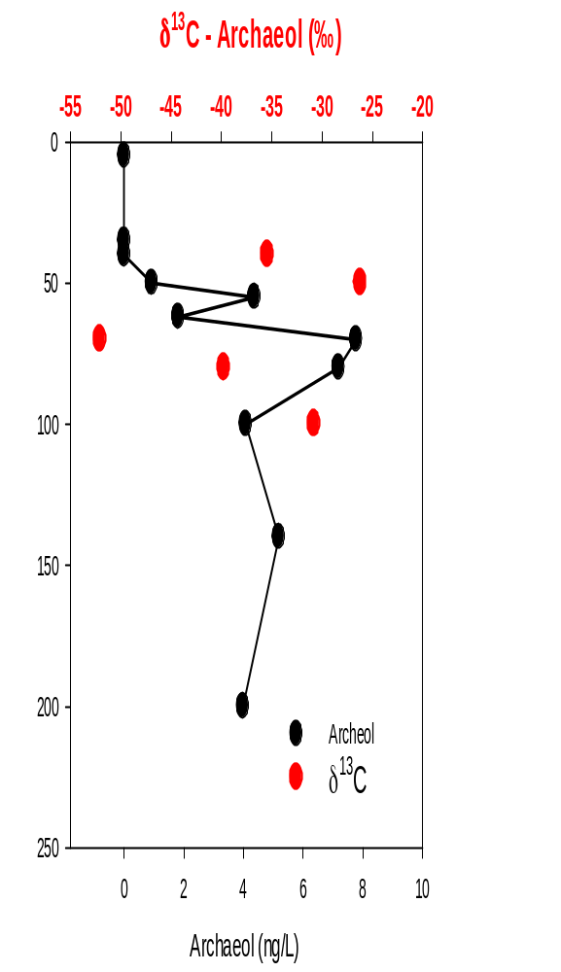
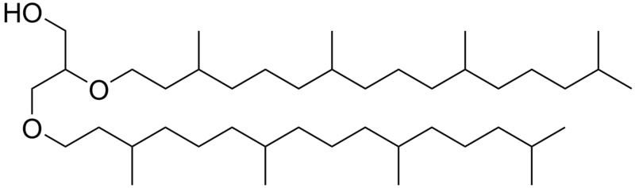
Biomarker for archaea
Archaeol
2,3-Di-O-phytanyl-sn-glycerol

Slide 9
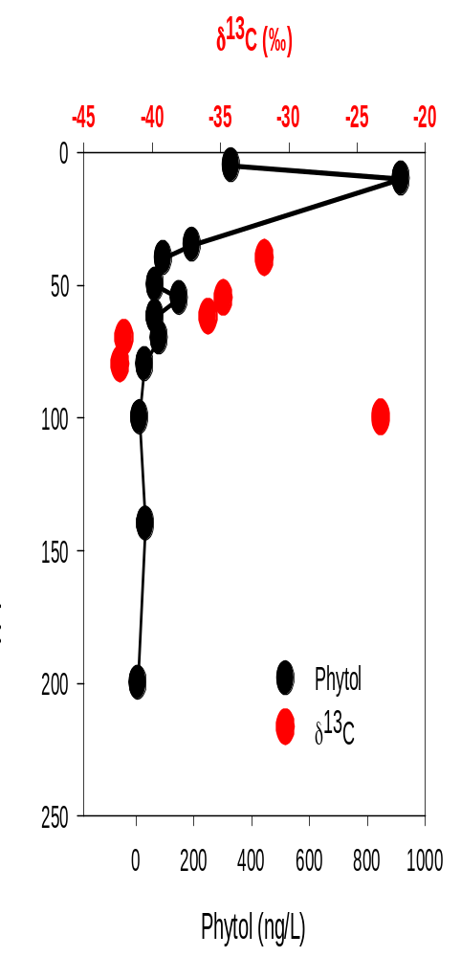

Biomarker for phytoplankton
Phytol
(3,7,11,15- tetramethyl-2-hexadecen-1-ol)

Slide 10
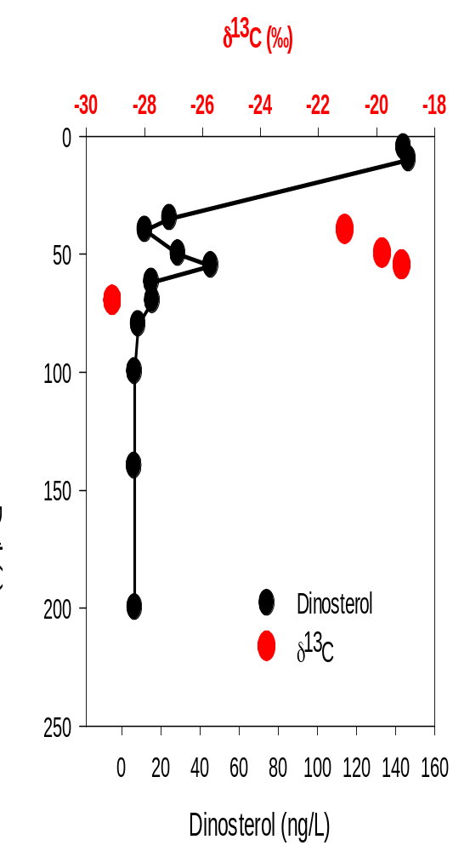
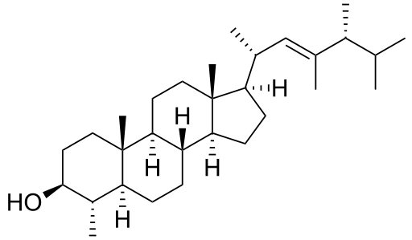
Biomarker for dinoflagellates
Dinosterol
(4α,23,24-trimethyl-5α-cholest-22E-en-3β-ol)

Slide 11
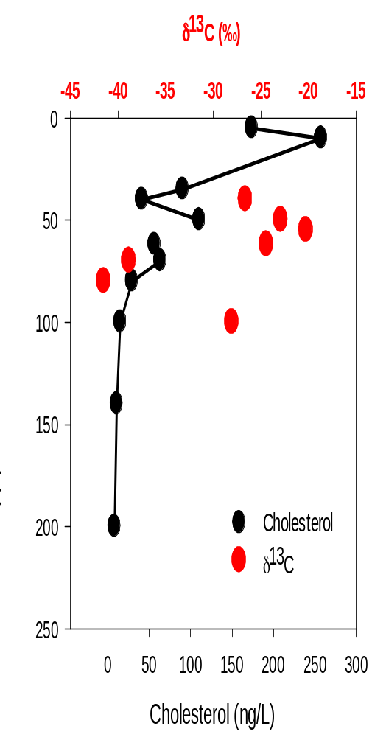
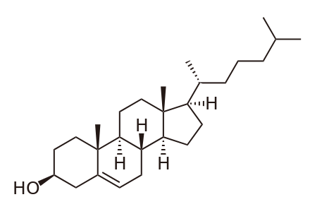
Biomarker for larger organisms
Cholesterol
(3β)-cholest-5-en-3-ol)

