Slide 1
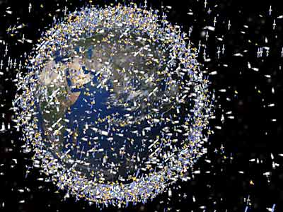
MARINE
PLASTIC POLLUTANTS
QUARCOO RICHMOND KENNEDY
BSc NAUTICAL SCIENCE
SUMMER SCHOOL 2016 #KL

Slide 2
OVERVIEW
ABOUT 6% OF THE WORLDWIDE OIL CONSUMPTION ARE USED FOR PLASTIC PRODUCTION.
RECYCLED PLASTIC PRODUCES 3.5 kg CO2 COMPARED TO 6kg FOR NEW PLASTICS/kg.
CURRENT WORLDWIDE PRODUCTION OF PLASTICS IS 35 kg per person INCREASING AT 3% PER ANUM.
DURABILITY (SLOW PHOTO DEGREDATION)
PERFECT MATERIAL FOR TOXIC ABSORBTION
40% OF PRODUCED PLASTIC IS DISPOSED WITHIN A YEAR
INCREASING AVAILABILITY OF SINGLE USE PLASTICS
DURABILITY (SLOW PHOTO DEGREDATION)
Pusch, Thema Umwelt, 1/2009,p.3

Slide 3
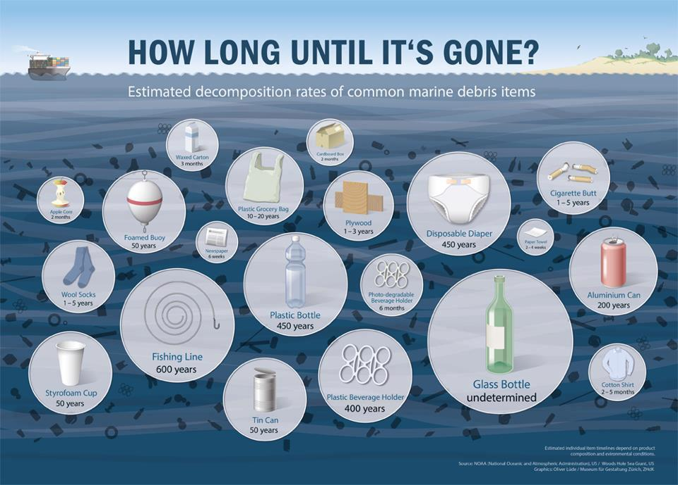

Slide 4
STATEMENT OF PROBLEM
DESPITE MARPOL ANNEX (V) INTERNATIONAL TREATY THAT PROHIBHITS THE DUMBING OF PLASTICS AT SEA,
PLASTICS IN THE OCEAN IS INCREASING AT ALARMING RATE.

Slide 5
SOURCES OF MARINE PLASTICS

Slide 6
IMPACTS
MUCH OF PLASTICS CONTAINS CHEMICALS THAT ARE HARMFUL TO MARINE ANIMALS.
IMPACT ON MARINE ORGANISMS (GHOST FISHING, INGESTION , ENTANGLEMENT )
SOME PLASTICS DISTRACT ENDOCRINE SYSTEM IN HUMANS AND MARINE ANIMALS.
ECOSYSTEM CHANGES
ECONOMIC LOST

Slide 7
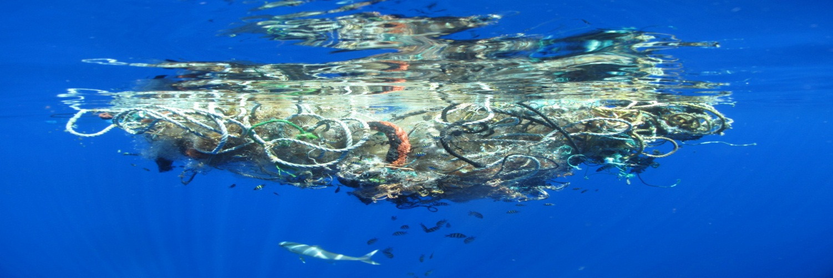
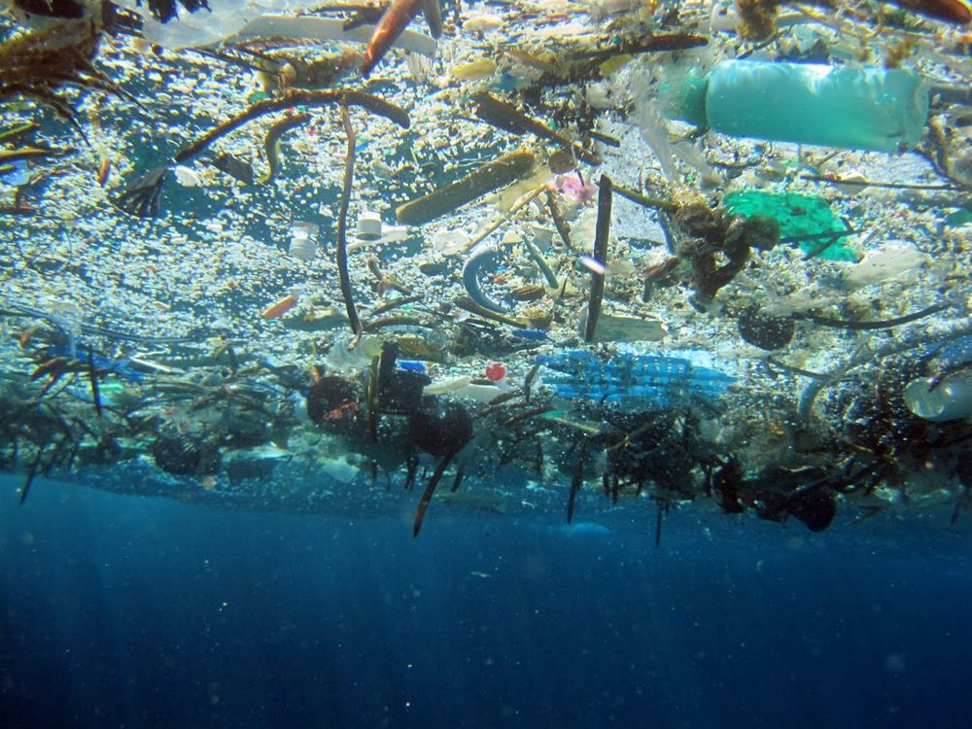
PP

Slide 8
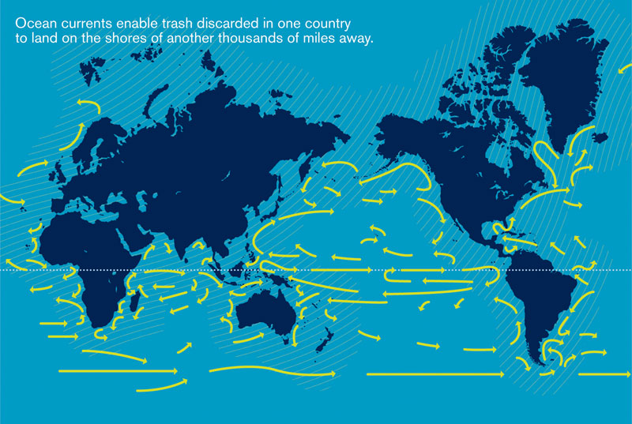
BUOYANCY OF PLASTICS

Slide 9
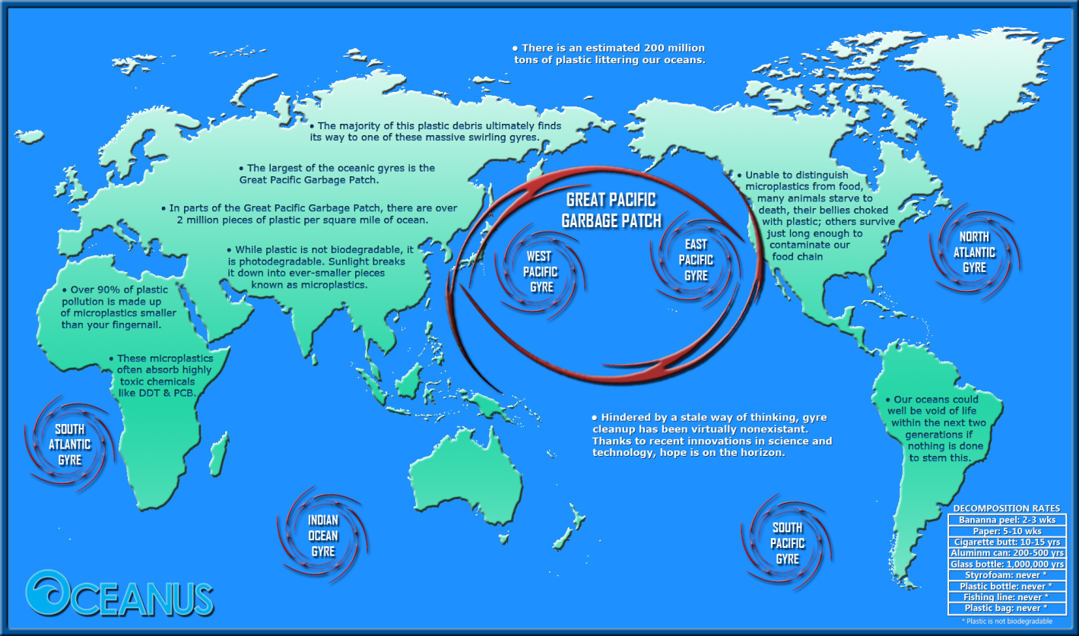

Slide 10
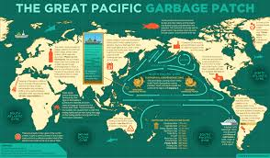

Slide 11
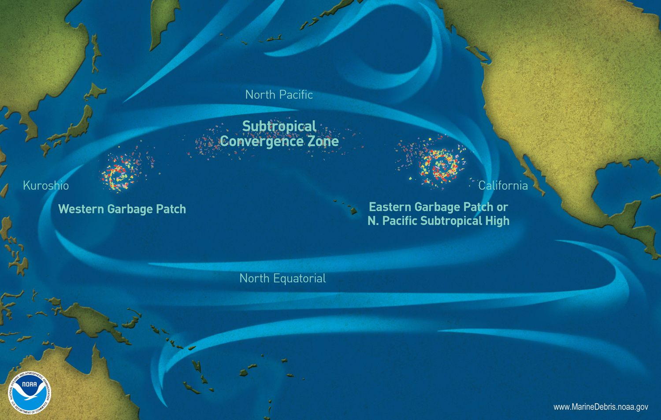

Slide 12
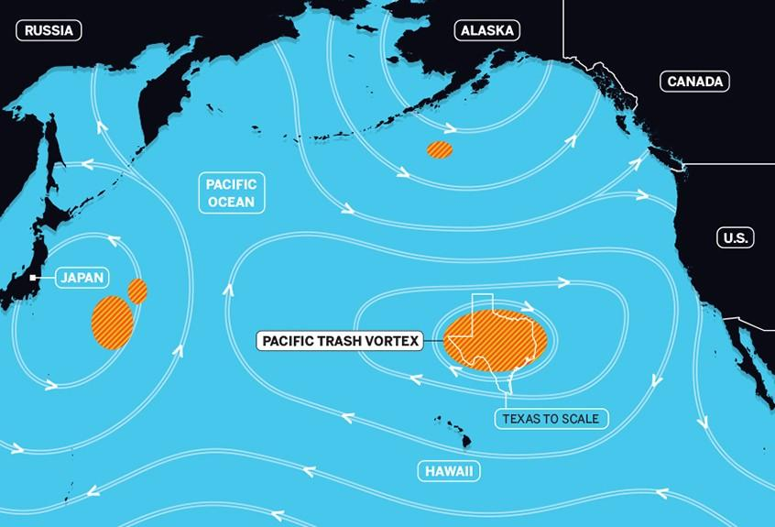

Slide 13
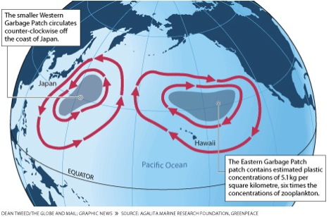

Slide 14
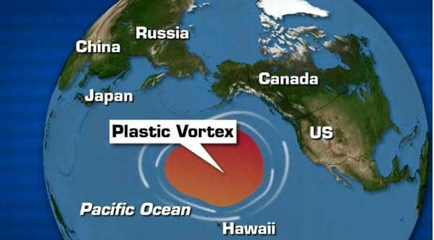

Slide 15
THE GREAT GARBAGE PATCH
3 million tons of Debris
90% OF DEBRIS IS PLASTIC
DISRUPTING OF OCEAN ECOSYSTEM DUE TO RAPID ACCUMULATIONOFPLASTICS BY CHANGING SPECIES HABITAT AND ENDAGERING MARINE LIFE.
NUMERICAL SIMULATIONSINDICATE THAT THE WASTE COULDTHUS REMAIN TRAPPED FROM TEN TO HUNDRED YEARS.
600,000 – 15,000,000 square Kilometers

Slide 16
THE WAY FORWARD
SOURCE REDUCTION
IMPROVED WASTE MANAGEMENT
BIO-DEGRADABLE PLASTICS
EDUCATION
RECYCLE
CLEANING THE GARBAGE PATCH
Microbial Decomposition
Technical task
POLICY AND MANAGEMENT
FURTHER STUDIES / RESEARCH

Slide 17
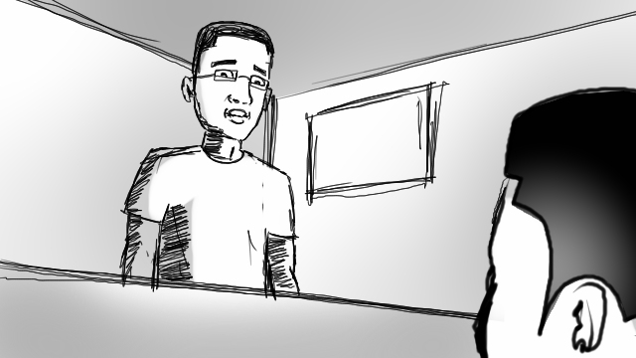

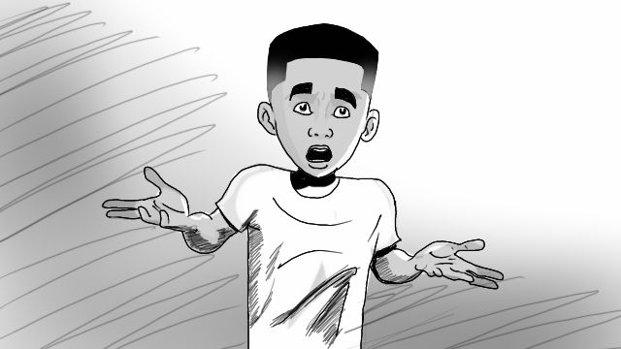


Slide 18

APPRECIATION
UNIVERSITY OF GHANA
UNIVERSITY OF MICHIGAN
SUMMER SCHOOL MATES
LECTURERS
REGIONAL MARITIME UNIVERSITY

Slide 19
EARTH IS HERE TO PROTECT MANKIND - #SAVEEARTH

Slide 20
THANK YOU
QUESTIONS , CONTRIBUTIONS AND COLLABORATIONS
klgh38@gmail.com

