Slide 1
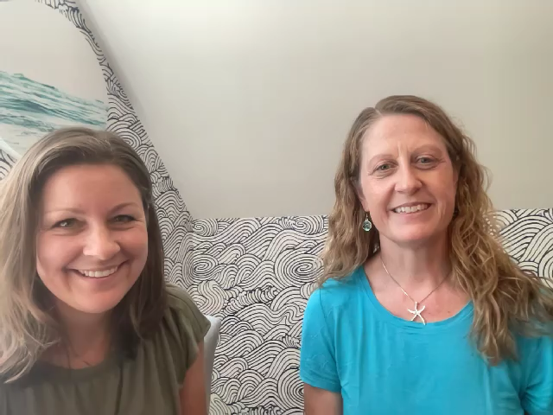


Sound in the sea:
What we can learn if we listen
August 2022
Lora Van Uffelen, ph.D.
University of Rhode island
Department of ocean engineering
Kathy Vigness-Raposa, Ph.D.
Inspire Environmental, Inc.
Notes:
Lora: Hi I’m Lora Van Uffelen an assistant professor at URI
Kathy: Hi I’m Kathy – principal scientist at Inspire Environmental
Lora: We wish we could be there in person, but we look forward to talking with you during a session Thursday afternoon about underwater sound. This short lecture will give you an intro to underwater acoustics and how researchers use sound to study the ocean.

Slide 2
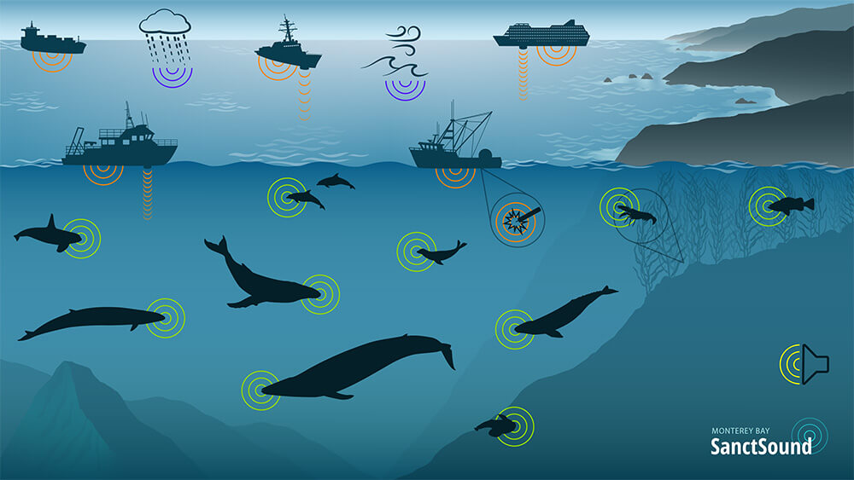

Outline
Why Underwater Sound?
Discovery of Sound in the Sea
Physics and Oceanography
Sound Measurement and Visualization
Underwater Soundscapes
Acoustics and the UN Decade
Notes:
Here’s a brief outline for our talk today. We'd first like to motivate why we are here giving this lecture on underwater acoustics today. Both humans and animals use sound underwater, and we're going to discuss why that is.
We'll also point you to a great resources for learning more about underwater sound: The discovery of sound int eh sea, or DOSITS website, then we'll go over some of the physics and oceanography that govern sound propagation in the ocean. We'll talk about how we measure and visualize sound, and then wrap up with a discussion of ocean scoundscapes and a UN Decade program focused on the Marine Acoustic environment

Slide 3
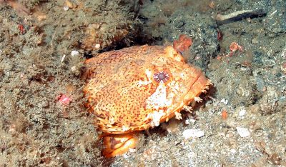
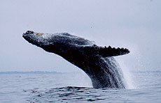
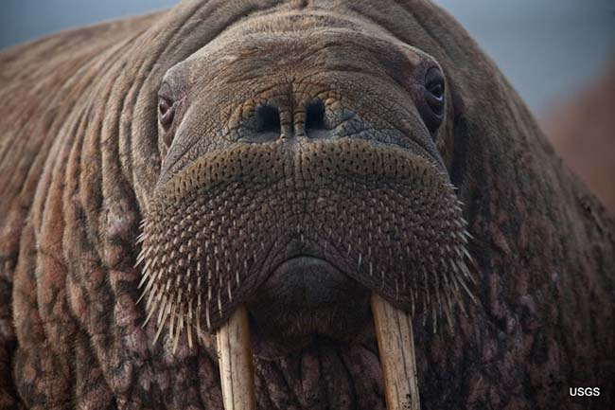

Why Underwater Acoustics?
Hearing is the universal alerting sense for all vertebrates
Many species of blind amphibians, reptiles, fishes, and mammals are known, but no naturally profoundly deaf vertebrate species have been discovered
Oyster toadfish
Reproduction
Humpback whale
Walrus
Notes:
We have titled our talk “What we can learn if we listen” because sound is such a critical sense for animals. Hearing allows animals to obtain information from all directions, making it the universal alerting sense.
May species of blind animals have been documented, but no naturally profoundly deaf vertebrate species have been discovered.
One example of the way in which animals use sound is through reproduction, The male oyster toadfish, walrus, and humpback whale make sounds to attract females to them during the reproductive season.

Slide 4
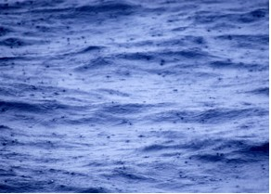
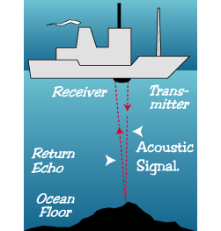
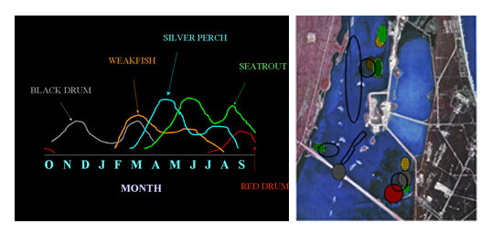
Why Underwater Acoustics?
By listening, we can learn so much!
Study weather
Sound travels far and fast underwater
Light is absorbed with the first 10s to 100s of meters within the ocean
Measure water depth
Determine time and location of spawning fishes
Notes:
Sound is important for humans in the marine environment too. Sound travels very far and fast underwater. While light is absorbed in the first tens to hundreds of meters in the ocean, sound is able to travel hundreds to thousands of kilometers.
Humans have capitalized on sound in two basic ways: active acoustics (where you make sound and listen for the returning echo) or passive acoustics (where you listen for sounds made by other sources). One example of active acoustics is measuring the water depth depth. Examples of passive acoustics include determine the time and location of spawning fishes. This study was done in a river in the state of New York, where scientists identified the month of the year when different species were present, detecting their spawing vocalizations. Scientists have also listened to the ocean to understand the weather and climate, such as the amount of rainfall or the lightning strikes.

Slide 5
DOSITS Resources
  Foundational website (dosits.org)
  Structured tutorials
  Instructional videos
  Webinars
  Printed/PDF 16-page booklet and trifold brochure
  Interactive eBooks (FREE!)
Notes:
This talk is going to introduce underwater acoustics, but if you want to learn more, the Discovery of Sound in the Sea or DOSITS project has developed lots of resources, all based on peer-reviewed, scientific information. Overall goal is to provide science-based education for a broad audience from students to regulators. There is the foundational website, which I will describe a bit more in the next two slides, then structured tutorials (a series of webpages that progressively develop your understanding of a specific science concept), instructional videos of science topics, webinars (60-minute interactive presentations by renowned scientists), printed or PDF 16-page booklet and trifold brochure, and interactive eBooks, available for free download.

Slide 6
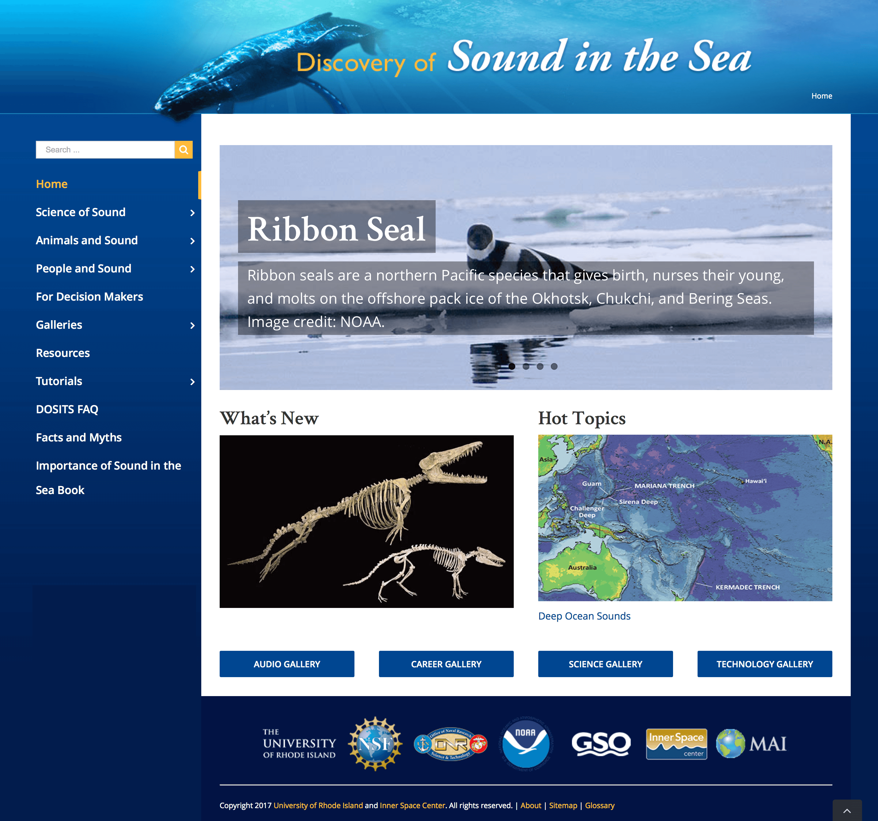

dosits.org
Notes:
This is the front page of the Discovery of Sound in the Sea or dosits.org website. With over 450 pages of content, DOSITS is the "go-to site" for scientists, regulators and others from around the world to use as a resource to learn about underwater sound and the issues of effects of sound. There is a scrolling ribbon across the top that highlights various content pieces. The What’s New box highlights new or updated content pages. Hot Topics are topics that are in the current news with links back to the foundational science literature on the topic. Content on the DOSITS website is divided into the Science of Sound (describing everything from what is sound, how is sound measured and characterized to advanced content on particle motion), Animals and Sound (including sound production and reception of marine mammals, fishes, and invertebrates, and the effects of sound on marine life), and People and Sound (how people use sound to accomplish the many tasks for which we use light in the terrestrial world). There are pages at a basic level (around 8th grade reading level) and advanced level (undergraduate level). There are also four galleries, including Audio Gallery (where you hear underwater sounds), Career Gallery (where you learn of the many careers that use underwater sound), Scientist Gallery (interviews of four scientists and how they came to be leaders in their fields), and Technology Gallery (that highlights all of the equipment and technology that is used in underwater sound research).

Slide 7
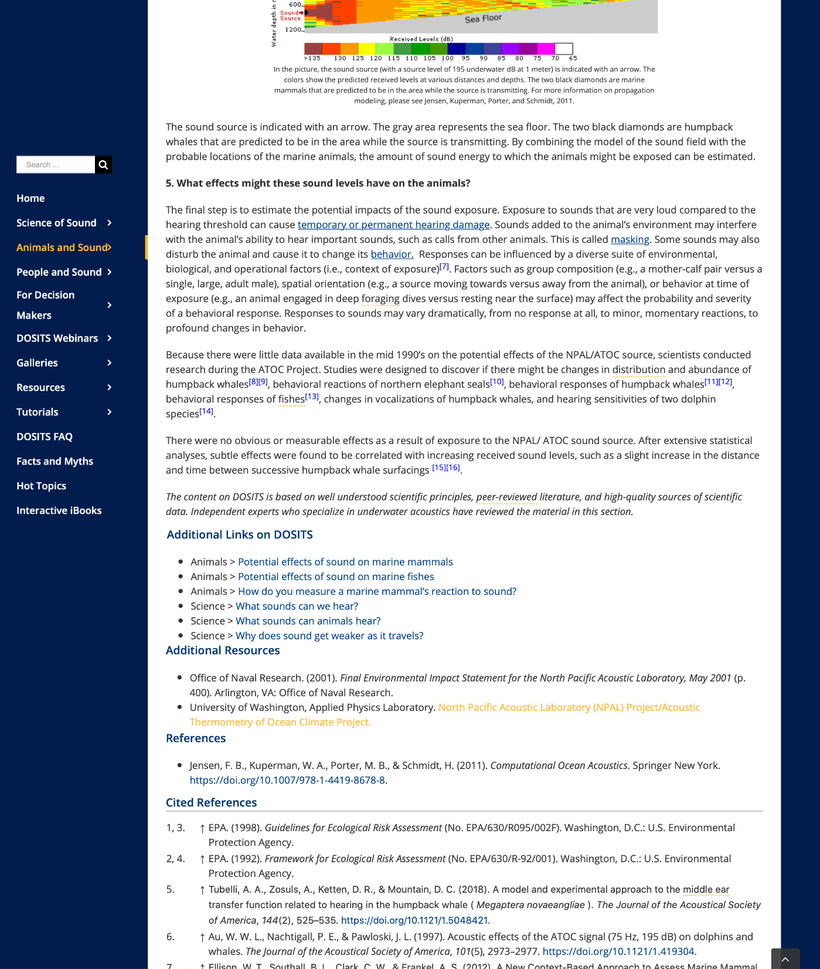
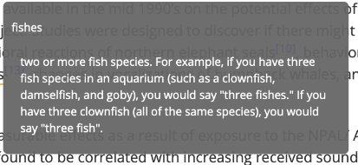
Internal links
Glossary terms
Inline citations to peer-reviewed literature
Full list of references, additional resources for more information
Notes:
This is what a webpage looks like. There are internal links so the curious users can go to more content related to the topic. There are glossary terms, where you hover your mouse over the word and the definition will popup. There are inline citations to the primary peer-reviewed literature. And finally, each page ends with a full list of the references and additional resources for more information.

Slide 8
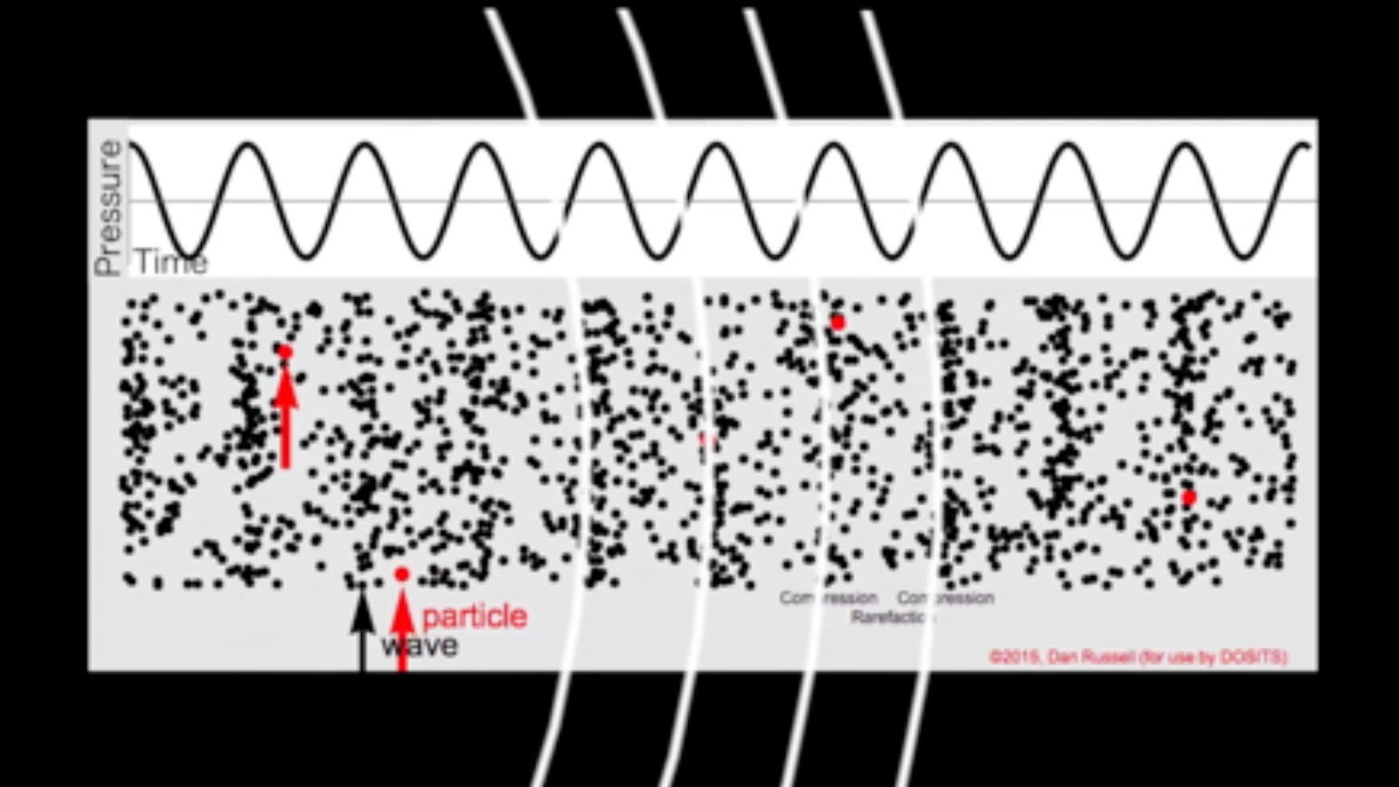
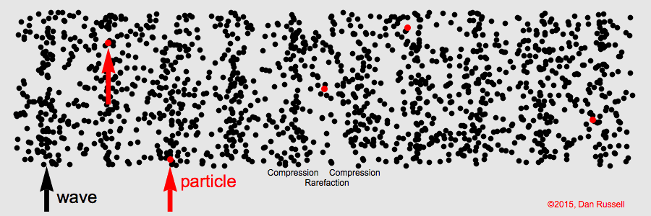
Physics: What is Sound?
Credit: Dan Russell, Penn State
Notes:
Have you ever heard that in space no one can hear you scream? That’s because sound cannot travel in a perfect vaccum as it is a mechanical wave and requires a medium.
Sound waves are made up of regions of compressions and rarefractions, that is, areas of high and low pressure as you can see in the animation shown here. Notice that the wave is traveling from left to right in this figure, but the individual particles are oscillating back and forth. Sound waves are longitudinal waves which means that the motion of particle is parallel to the direction that the wave propagates.

Slide 9
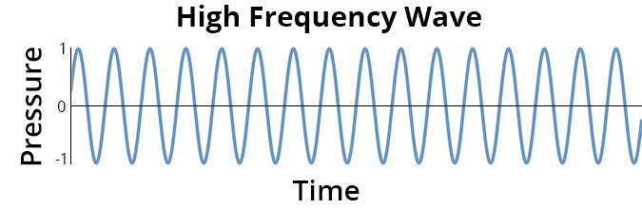
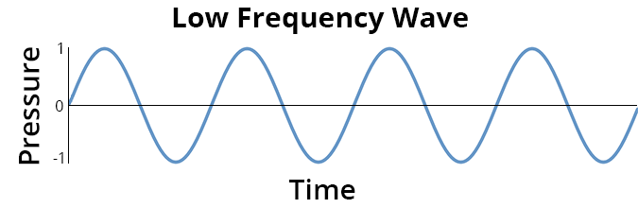
Characterizing Sound:
Frequency or pitch has units of Hz (cycles/sec)
Notes:
One way of characterizing acoustic wave is by the frequency which we perceive as pitch. High pitched sounds have more of these compressions and rarefractions per unit time than do lower frequency sounds. Frequency is quantified in cycles per second or Hertz.

Slide 10
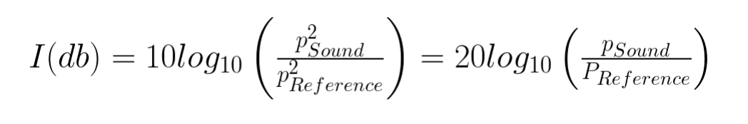
Characterizing Sound: Amplitude (loudness) Typically reported in decibels (dB)
Pressure amplitude is related to Intensity
Sound pressure levels can be computed directly from the measured pressure
Sound pressure levels are reported relative to a reference value
This is the relationship between measured pressure and intensity:
Notes:
We can also characterize a sound wave by it's amplitude, which we perceive as loudness.
The pressure amplitude of a signal is related to the intensity of the signal ,and sound pressure levels can be computed directly from the measured pressure.
Sound pressure levels are reported in decibels or dB, which is a logarithmic unit, and are reported relative to a reference value. In the ocean, a referecne value of 1 micropascal is used, but in the air this is 20 micropascals, so I want to emphasize that a dB in air is not the same as a dB in water.
We can calculate the intensity of sound in dB using the equation below, which shows that intensity is proportional to pressure squared.

Slide 11
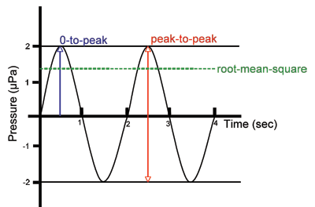
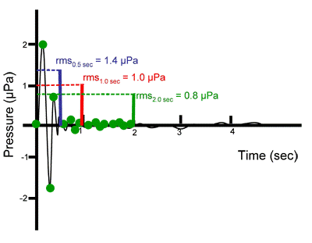
Sidebar: Signal levels reported in dB
https://dosits.org/science/advanced-topics/introduction-to-signal-levels/
Notes:
As a side note, even if we use the proper reference value, there can still be some confusion about what a dB means. When reporting values in dB, it should also be noted whether the pressure value is calculated as a peak-to peak value, an amplitude measured from 0 to the peak pressure, or a root-mean-square (rms) of the pressure signal, as demonstrated in teh figure on the left.
Most acoustic signals either in the air or underwater are not perfect sinewaves. The figure on the right demonstrates further that when using a rms of a signal, it also matters how much of the signal is used for the rms calculation. Here using only the fist 1/2 of a second yield an rms pressure of 1.4 uPa, using 1-second yeilds 1 upa and taking the rms pressure of 2 seconds is 0.8 uPa.
We're not going to go more into this here, but the link below provides more information on the topic.

Slide 12
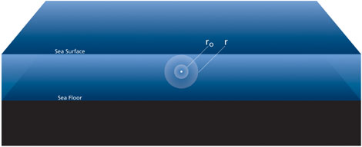
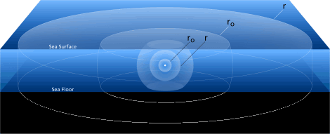
Geometric Spreading
Spherical (near field)
Cylindrical (far field)
Notes:
We know intuitively that as we get farther from a sound source, the signal will be quieter.
If we assume that a sound source is omnidirectional, that is sound spreads out in all directions, the sound will move out spherically from the source. Since power is conserved (power is equal to intensity x area) this is like blowing up a balloon where the same amount of power is distributed over a growing surface area of a sphere. The intensity of the sound therefore decreases as you move out in range.
As we all know, the ocean is bounded by the sea surface and seafloor. At some point this growing sphere will touch the surface and seafloor and the geometric spreading will transition to cylindrical spreading. Thiis slows down the decrease in intensity as you move out in range because the power is now distributed over the surface area of a cylinder rather than a sphere.

Slide 13
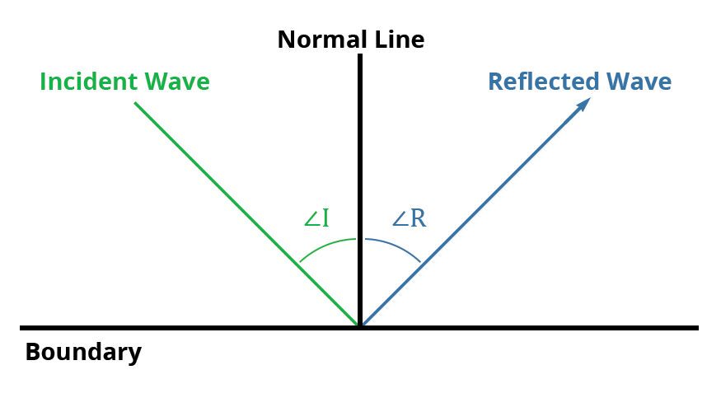
Reflection
Notes:
When sound wave is incident upon the sea surface it will be reflected back into the ocean at the same angle that it is incident. The same occurs at the seafloor, but the properties of the seafloor govern how much sound is reflected back into the ocean and how much is transmitted into the seafloor.

Slide 14
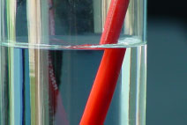
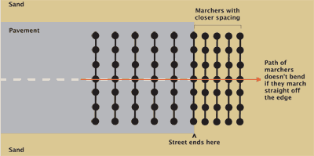
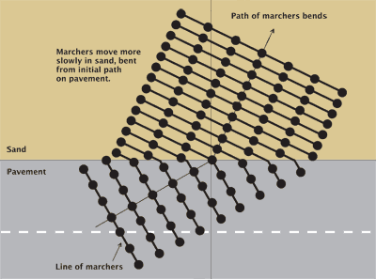
Refraction: Snell’s Law
Notes:
When sound is trasnmitted into the seafloor, it bends or refracts. The angle of refraction is governed by Snell's law which also describes how light bends in different media as demonstrated by this picture of a pencil in a glass of water.
In optics we usually use the index of refraction to calculate the angle at which light will bend when it enters a new medium. In acoustics we use the sound speed. It is easier to understand why this is if we think of lines of marchers on a street. The line of marchers represent the pressure wave and the will travel faster on pavement than on sand . If we think of our sound wave as these marchers, it will also slow down when it reaches a slower medium as demonstrated in the figure on the left. If the sound is incident directly, there is no change in angle, however, if the acoustic wave is incident at an angle, the acoustic ray will bend. The acoustic ray is is the line parallel to the regions of high and low pressure or our lines of marchers. If the marchers (or sound ray) move from a higher sound speed to a lower sound speed, the ray will bend towards the normal and if they move from a lower sound spped to a higher sound speed, it will bend away from the normal
To summarize Snell's Law: Sound bends towards areas of low sound speed.

Slide 15
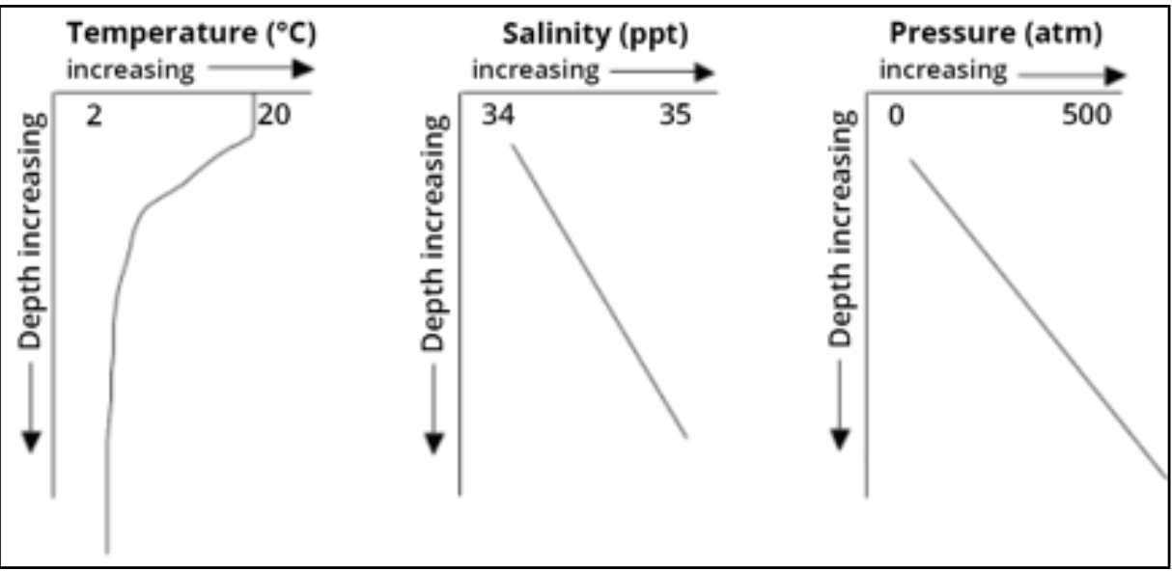
Speed of sound in seawater
Depends on temperature, salinity, and pressure
  Higher Temperature = Faster
  Saltier = Faster
  Higher Pressure = Faster
Effect on Sound Speed
  Temperature 1°C = 4.0 m/s
  Salinity 1PSU = 1.4 m/s
  Depth (pressure) 1km = 17 m/s
Notes:
The speed of sound doesn’t just change in the seafloor, it is also quite variable in the ocean itself. The speed of sound depends on temperature, salinity, and hydrostatic pressure. Higher temperatures, higher salinity, and higher hydrostatic pressure all lead to higher sound speeds. Salinity has a relatively small impact on sound speed. The increase in sound speed due to hydrostatic pressure is pretty predictable as it increases linearly with depth.
Becuase sound speed depends on temperature, salinity, and pressure, CTDS are extremely important meaurements for understanding sound propagation in the ocean.

Slide 16
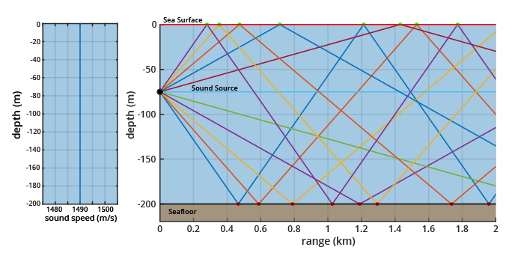
Shallow Water
Notes:
I want to show just a few different sound propagation environments n the ocean. In this one, which is a simplified shallow water profile with a constant sound speed (shown on the left), the sound propagation is dominated by reflection. The sound waves travel out from the source in straight lines because there is no change in sound speed and they reflect at the boundaries.

Slide 17
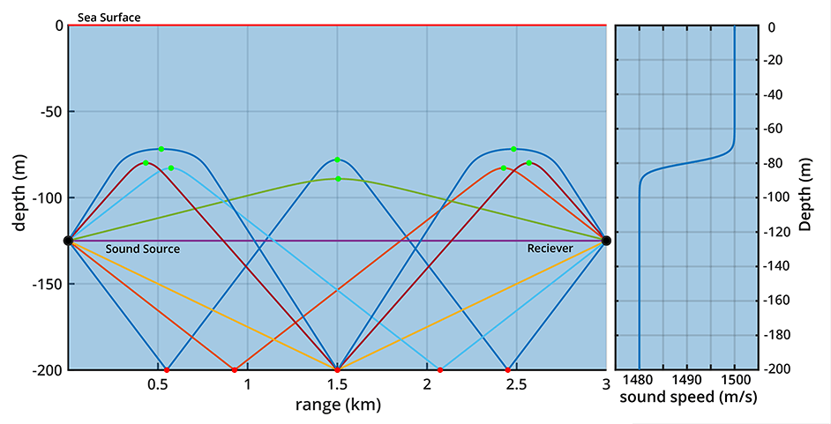
Summer Thermocline
Notes:
If we add a summer thermocline where the top 80 m or so are warmer, we see some refraction. The sound rays go out from a source at 125 m depth and travel in a straight line in the lower path where the sound speed is constant, but when they encounter the higher sound speed due to warmer temperatures in the upper ocean, they start to refract or bend back to the area of lower sound speed.

Slide 18
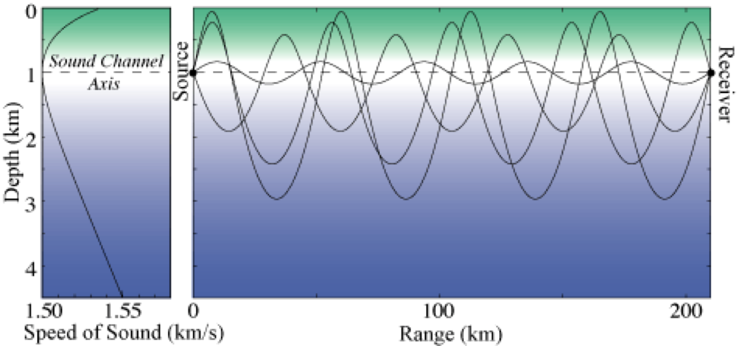
Deep Water:
SOFAR Channel Propagation
From Dosits: Adapted from Munk et. al. 1995
Notes:
Deep water sound propagation is dominated by refraction. In a deep water profile there is an increase in soundspeed near the surface because the surface of the ocean is warmer in most of the world's oceans. There is also an increase in soundspeed due to pressure in the deep ocean. This increase in the upper and deep ocean creates a sound speed minimum which is referred to as the sound channel axis. Sound rays transmitted from this depth will bend back towards the regions of lower sound speed. This is also referred to as the SOFAR Channel (SOFAR stands for Sound Fixing and Ranging). The sound is channeled by refraction due to the sound-speed profile and it doesn't interact with the surface or the seafloor. This is what enables sound to travel for very long distances in the ocean. Sound trapped in this channel can travel across entire ocean basins.

Slide 19
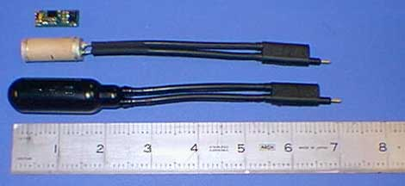
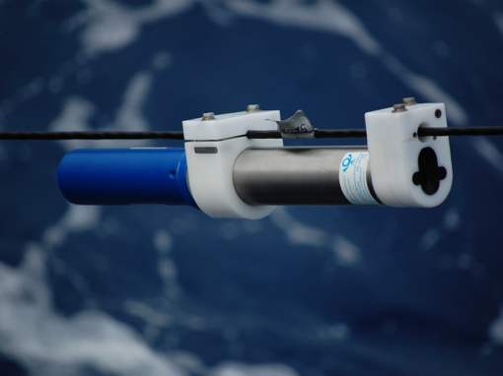
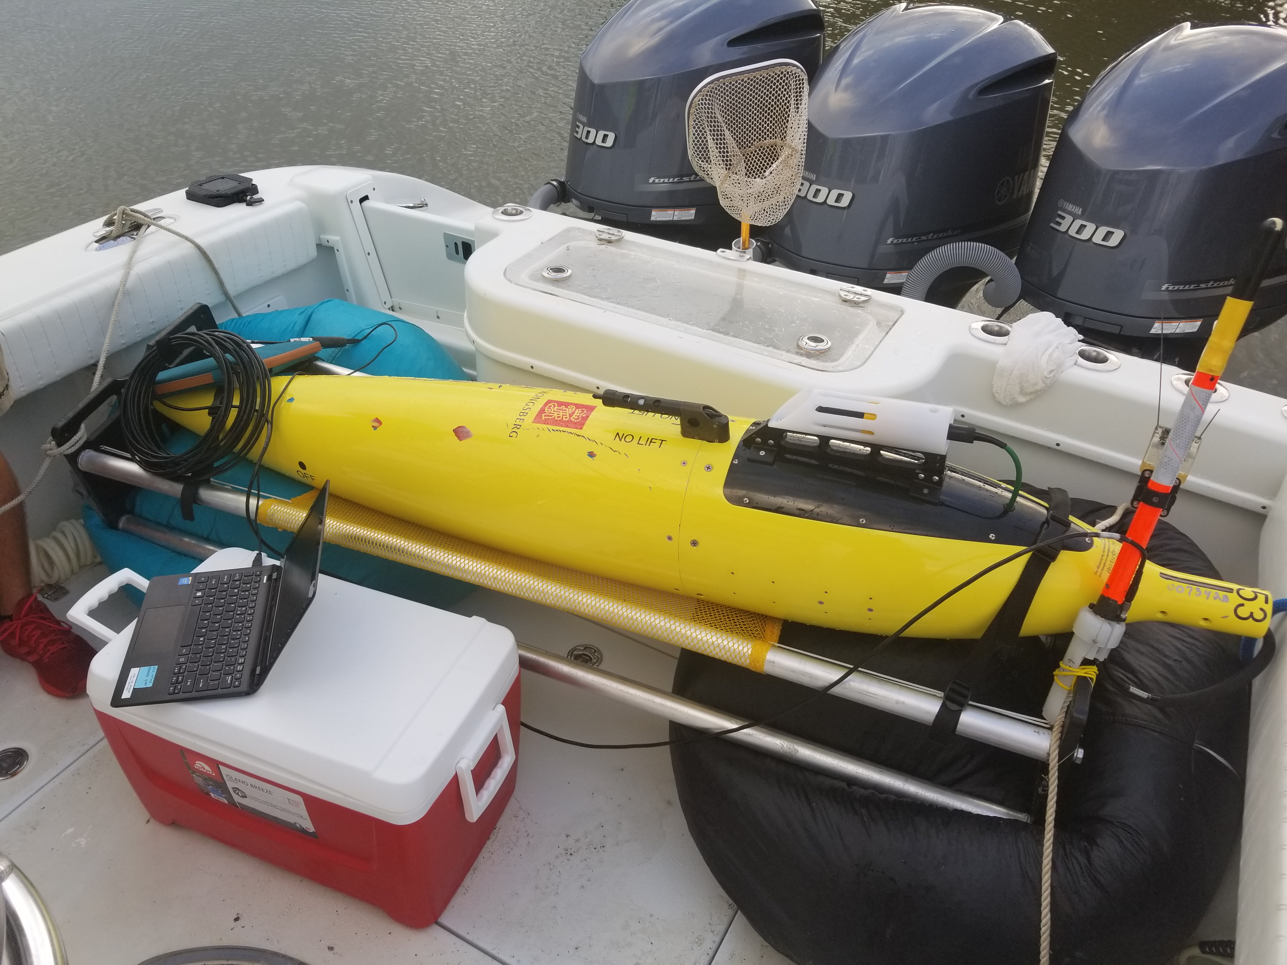
Measuring Sound: Hydrophones
Notes:
Sound is measured with hydrophones, which are underwater microphones. Most Hydrophones are made from a piezoelectric material that responds to pressure by emitting an electrical signal which is what is measured. Recording this signal allows the measurement of the amplitude and frequency of the acoustic pressure signal.
Hydrophones can be mounted on frames to be fixed to the Seafloor, they can be mounted on mooring wire and suspended on a mooring as shown on the lower left, or they can be mounted on underwater vehicles. The picture on the lower right shows a Seaglider autonomous underwater vehicle that we use in my lab at the University of Rhode Island. The white housing just behind the Conductivity and temperature sail houses the hydrophone itself and there is a small pressure case inside the fairing of the Seaglider that contains the electronics and data storage.

Slide 20
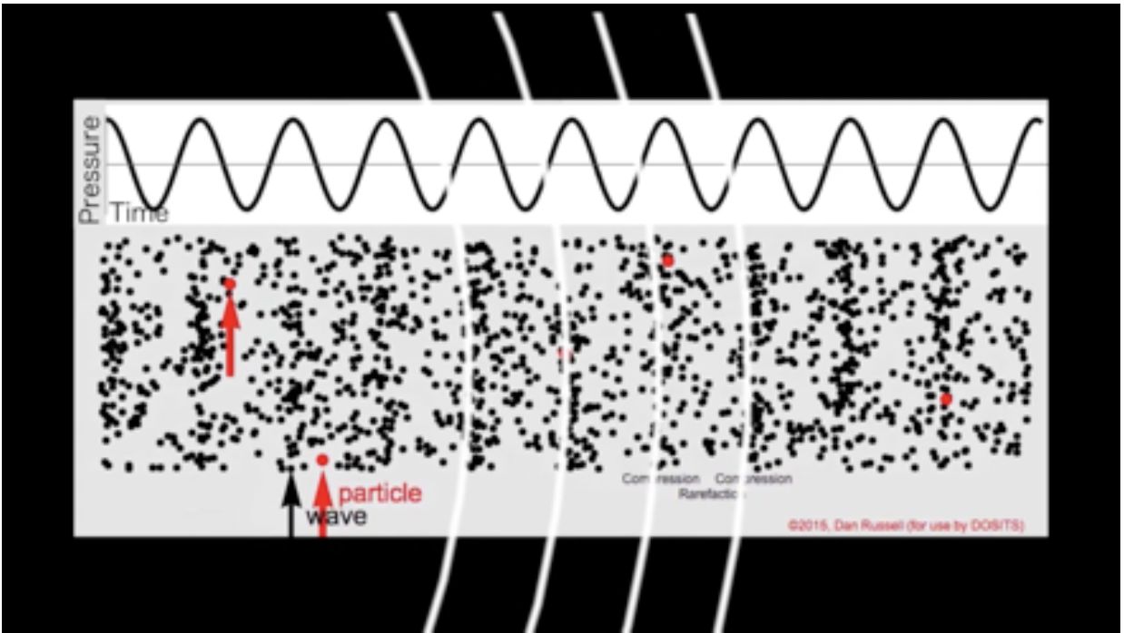
Measuring Sound:
Pressure and Particle Motion
Credit: Dan Russell, Penn State
Notes:
I also wanted to note that a hydrophone is the most common underwater acoustic receivers. Hydrophones measure the acoustic pressure signal, but there are also sensors that measure the particle motion.
Acousitc vector sensors measure both the particle motion and pressure changes associated with a sound wave, while hydrophones measure only the pressure signal.

Slide 21
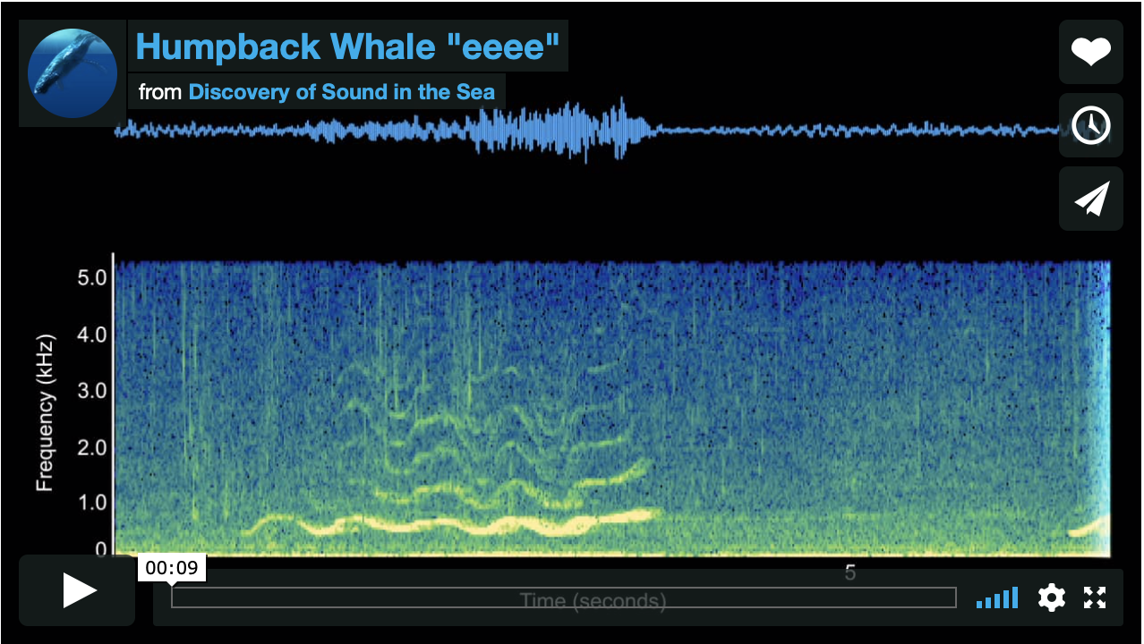
A spectrogram is a visual representation of the frequency content of a signal as it varies with time.
We can see what’s in the recording, but not much detail.
We can see much more information in a spectrogram
https://dosits.org/galleries/audio-gallery/marine-mammals/baleen-whales/humpback-whale/?vimeography_gallery=12&vimeography_video=226917123
Notes:
We can look at an acoustic pressure signal, which you can see as the blue line at the top of the screen grab that I took from the DOSITS site. From this pressure signal you can see where the amplitude increases and decreases, that is, where the signal gets louder and quieter, but it's hard to tell much else from this timeseries plot.
We can use signal processing to take this signal and break it down into frequency components. A spectrogram is a visual representation of the frequency content of a signal as it changes with time.
This gives us a lot more information that we would have from the timeseries alone.
This particular spectrogram shows a call from a humpback whale with frequency on the y axis and time on the x axis. Bioacoustics researchers can often determine what the source of the signal is from just looking at a spectrogram. Different species of animals produce characteristic calls that can be recognized from the frequency content and durations of the signals.

Slide 22
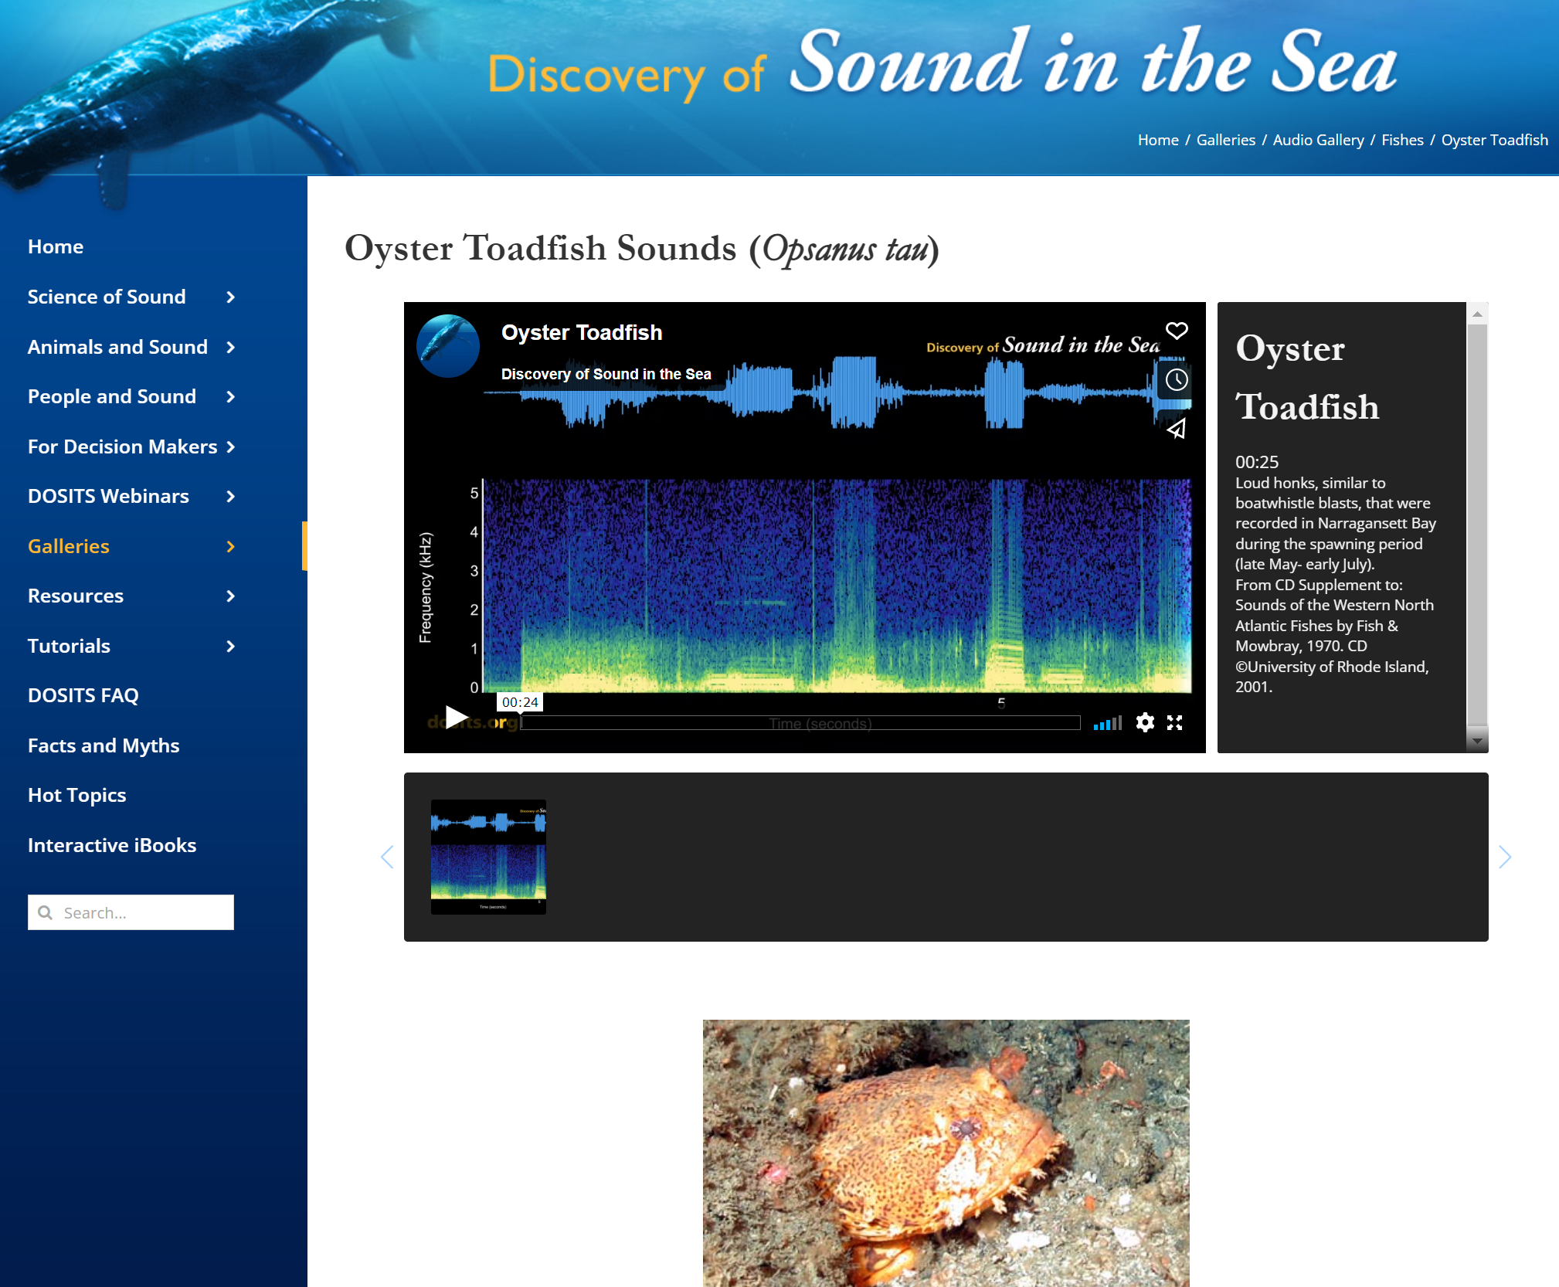
Learn from Listening: Oyster toadfish
We can see what’s in the recording, but not much detail.
We can see much more information in a spectrogram
https://dosits.org/galleries/audio-gallery/fishes/oyster-toadfish/
Notes:
As Lora mentioned, bioacousticians can use information in the spectrograms to detect and classify or identify that a particular sound source, such as a species of fish, is near their hydrophone at a specific time. Coming back to our oyster toadfish, here is a recording of the vocalizations made by male oyster toadfishes in their burrows to attract females.
These and other sounds are available for your enjoyment in the DOSITS Audio Gallery.
OTHER RESOURCES:
: https://www.mbari.org/soundscape-listening-room/?fbclid=IwAR0ZKGCxmfrk3Umkkj-CD6hUH7FefUFMa93q3Tk4m8U7PNT1mdT75-54k6Q

Slide 23

What is an underwater soundscape?
landscape => acoustic landscape = soundscape
Notes:
Scientists use the sounds they record on their hydrophones to characterize the underwater soundscape. A soundscape can be thought of as an acoustic landscape. This is a picture of a mountain village landscape. We can visually identify different components of this landscape – we can count the number of homes, see the snow on the mountains, measure the length of the road. Similarly, we can use our ears to listen to the ambient noises or sounds of a soundscape to identify its components.

Slide 24
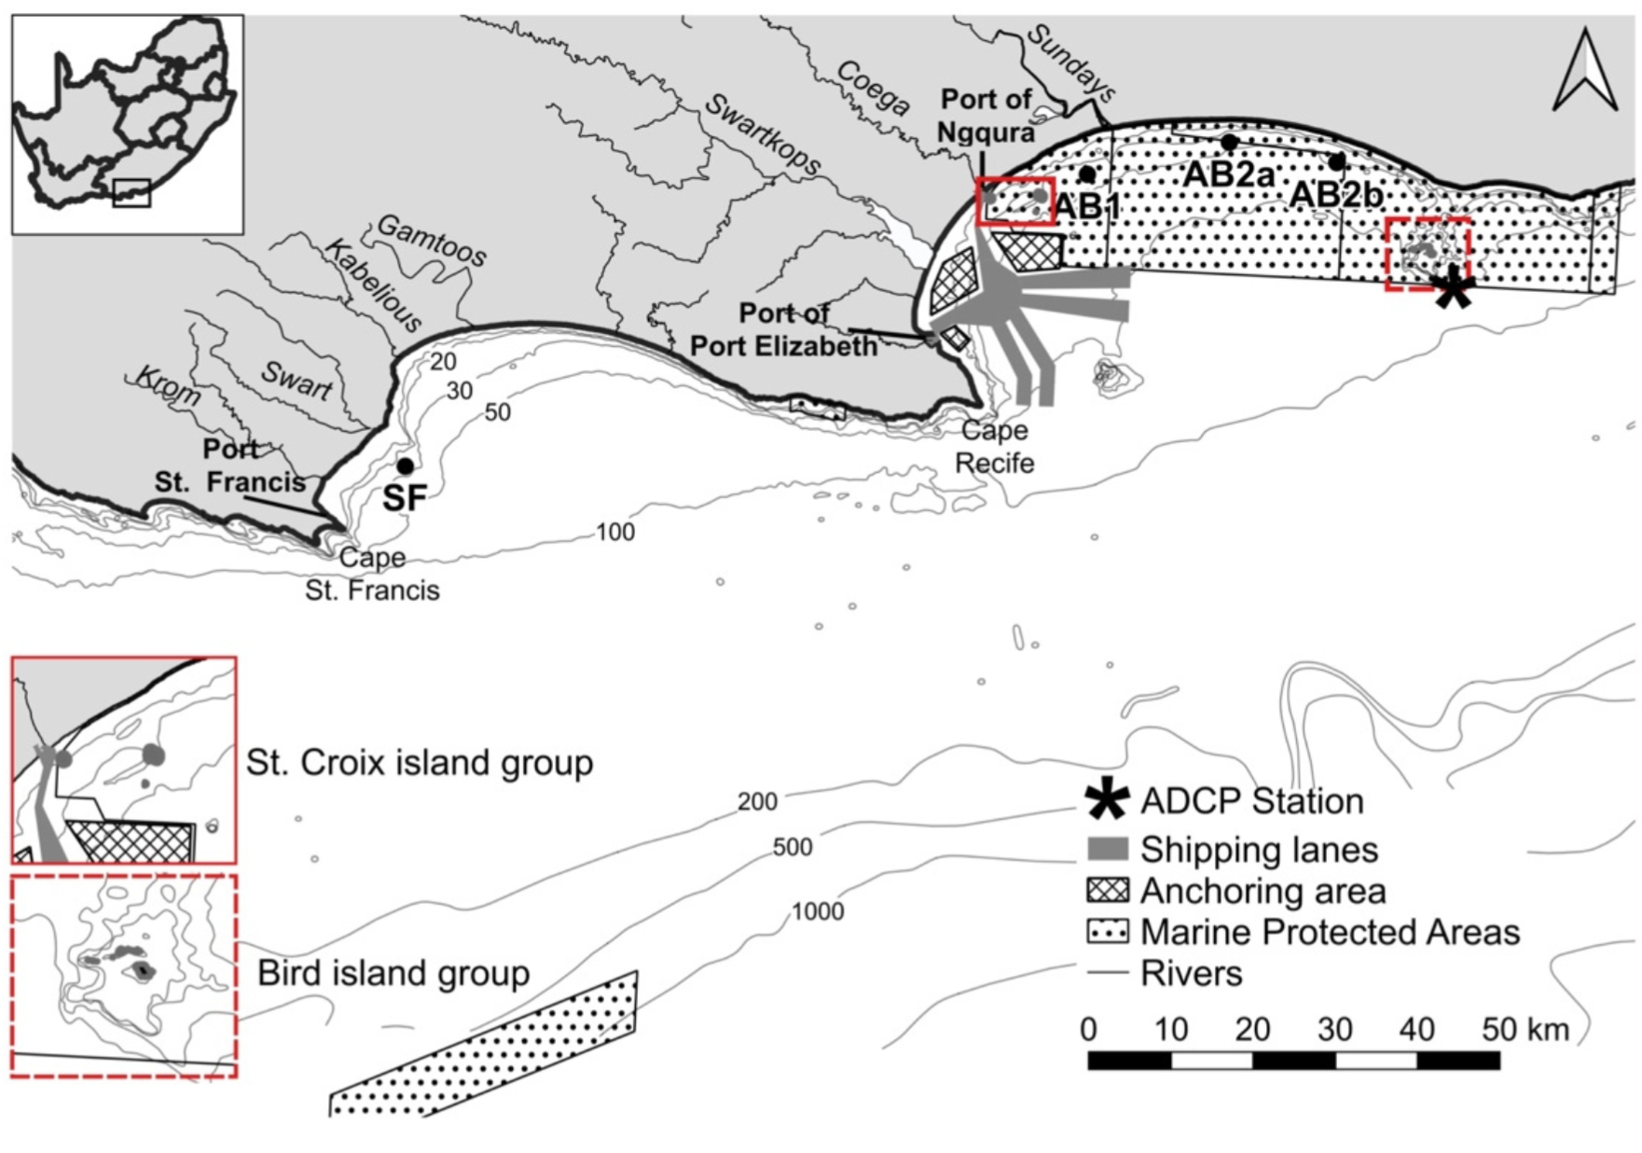
What is an underwater soundscape?
International Organization for Standardization (ISO) Technical Committee on Acoustics: Underwater Acoustics Subcommittee
  “Characterization of the ambient sound in terms of its spatial, temporal, and frequency attributes, and the types of sources contributing to the sound field” (ISO 18405:2017)
  Very clear that ambient sound is
    location-specific
    time-specific
    Example study: Schoeman et al. 2022
      Underwater soundscapes of two bays in South Africa
Schoeman, R. P., Erbe, C., & Plön, S. (2022). Underwater Chatter for the Win: A First Assessment of Underwater Soundscapes in Two Bays along the Eastern Cape Coast of South Africa. Journal of Marine Science and Engineering, 10(6), 746. https://doi.org/10.3390/jmse10060746
Notes:
The International Organization for Standardization has defined soundscape of the characterization of the ambient sound in terms of its spatial, temporal, and frequency attributes, and the types of sources contributing to the sound field.
An example of a study of the soundscapes of two bays, St. Francis Bay (west) and Algoa Bay (east) along the Eastern Cape coast of South Africa, shown in this figure. Acoustic recorders were placed at the black dots labeled SF, AB1, AB2a, and AB2b. Shipping lanes and anchoring areas are depicted in the northwest section of Algoa Bay. Boundaries of Marine Protected Areas (MPAs) are depicted by the dotted boxes.

Slide 25
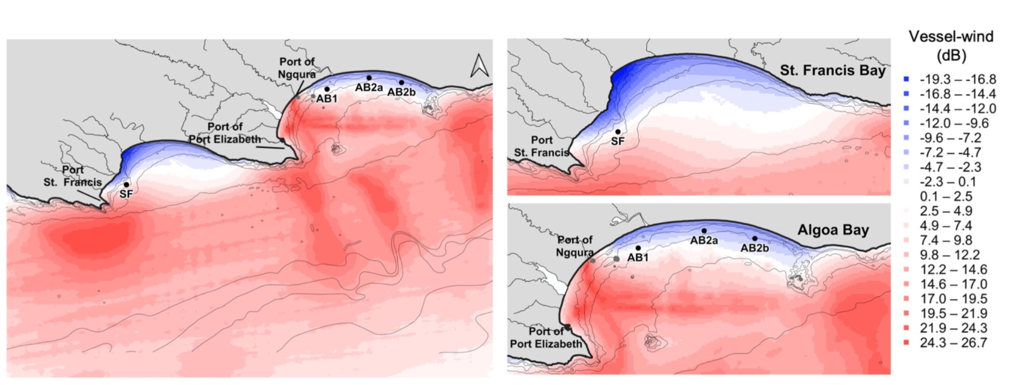
What is an underwater soundscape?
Modeled vessel noise less modeled wind noise
  Blue = wind-dominated acoustic environment
  Red = vessel dominated acoustic environment
Schoeman et al. 2022
Notes:
Underwater acoustic data were collected between February 2015 and March 2018. Recorders monitored underwater sound at a sampling frequency of 48 kHz for 15 min every 60 min in 2015 and for 5 min every 20 min in 2016-2018. Spectrograms were analyzed to identify prominent sound sources and their pattern of occurrence. These figures show modeled vessel noise less modeled wind noise, so that blue areas are wind dominated soundscapes and red areas are vessel dominated soundscapes.

Slide 26


High-Level Objectives
Ocean Decade Research Programme on the Maritime Acoustic Environment (UN-MAE)
Sound contains information about source(s) modified by interactions with the environment and objects within the environment.
Acoustic Environment → Listen and Assess → Biological and Physical Environment
(Signal) (Information)
Acoustic Environment ← Model and Predict ← Biological and Physical Environment
(Output) (Inputs)
Objective and quantitative measures in a vastly undersampled environment is a challenge!
Working to expand the community of ocean scientists and practitioners conversant in the MAE to address interdisciplinary challenges
Notes:
As part of the United Nations Decade of Ocean Science for Sustainable Development, we are working on the Programme on the Maritime Acoustics Environment.
The objectives of the MAE Program are to understand that sound contains information…

Slide 27
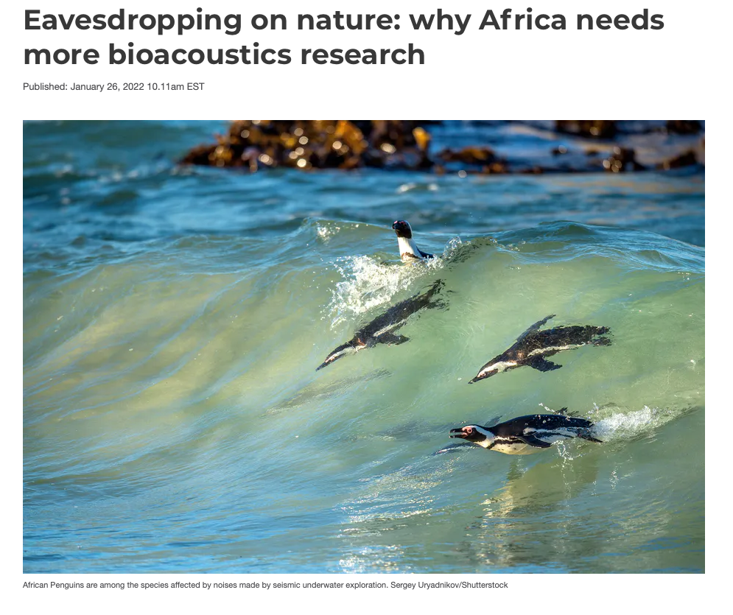
Join us for a discussion Thursday at 2pm
Zoom link: https://uri-edu.zoom.us/j/96961372206?pwd=RW4zWjlHMm5PMERoMkNvWkdJelFSZz09
Meeting ID: 969 6137 2206
Passcode: 005607
Topics for Discussion:
  Sources of underwater sound off the coast of Western Africa
  Techniques and equipment for measuring sound in coastal waters
  Building partnerships for research that utilizes acoustics
Notes:
Thanks for joining us to learn a little bit about underwater acousitcs. We'd love to talk to you. We're going to be hosting a discussion on Thursday at 2pm at the Zoom link shown below. Please join us!
The lecture we just gave was a pretty general overview of underwater acoustics, but when we get toehter for the discussion, we'd like to gear it more towards acoustics topics relevant to Western Africa.
I included a screen grab from a January 26 article from the Conversation regarding 2022 paper by Becker et. al. that states that Africa needs more bioacosutics research!We'd like to talk to bioacousticians or non-bio acousticians from Africa and start to build partnerships for acoustics research.
In future implementations of the summer school we'd also love to join in person and maybe go out and make some acoustic measurements. We've never worked in Western Africa though, so we'd love to learn from you and discuss what sources of sound off Western Africa might be and also discuss techniques and equipment for measuring sound in these coastal waters.
We hope to see you Thursday on Zoom!

